Slide 1
Driving license controlled smart vehicle
Team ID : TG001534
Team Leader : Rajat Saraswat
Problem ID : GIH090

Slide 2
Work and Implementation :
The proposed system consists a smart driving license card combined with RFID(RC522) technology.
All the hardware modules like fingerprint scanner(R305), camera(PiCam)and RFID module are interfaced with the Raspberry Pi 3B+ , which is the main processing and control unit of the system.
The user will first Scan his smart License card on the RFID tag which will create a link to his database where the user’s information is stored along with his biometric data.
Now the person will put his finger on the fingerPrint scanner, the FP scanner will create a image of his fingerprint and feed to the matching algorithm.
Simultaneously, the Camera attached to the system will start scanning and capturing pictures of the face of the person and feed it to the face matching algorithm.

Slide 3
Both the inputs from the fingerPrint scanner and Camera module are feed to the triangular matching algorithm.
This algorithm will try to match the user inputs of fingerprint and face image model with the data stored in the user database.
The ignition system of the car engine will be controlled by a relay switch which is interfaced with microcontroller of the system.
If the data are matched, only then the car engine will start, and if the matching of data fails then the car will not start.

Slide 4
II. Technology/Tools Implemented A. Raspberry Pi 3B +
In this project, the main block of authenticated access control for vehicle ignition system is the development board Raspberry Pi 3B +
It is fed with the required input signals from various parameters like fingerprint scanner, camera, RFID, etc.
These parameters send signals, each to individual pins of the microcontroller. The microcontroller then branches out to any one of the logical paths and delivers the output at one of its pins.
When all the test cases are verified, only then the engine is set to ignition.

Slide 5
B. Fingerprint Module (R305)
This is R305 Fingerprint Identification Module Fingerprint Lock Optical Development Board with TTL UART interface. It can store upto 1000 different fingerprints.
It can store the fingerprint data in the module and can configure it in 1:1 or 1: N mode for identifying the person. The FP module can directly interface with 3v3 or 5v Microcontroller.
When the person put the finger on the reader, the LED will emit IR rays. The place where the IR rays are absorbed will be appeared as a dark and remaining will be light. Now the CCD camera below the fingerprint reader will capture the image appeared. It will send the signals to the microcontroller to match it with biometric data stored in user’s database.
C. Raspberry Pi Camera (V2)
8-Megapixel native resolution high-quality Sony IMX219 image sensor
Cameras are capable of 3280 x 2464 pixel static images.
The camera module connects to the Raspberry Pi board via the CSI connector which is capable of extremely high data rates and it exclusively carries pixel data to the processor.

Slide 6
D. RFID TAG and Reader
An ADC (Automated Data Collection) innovation that utilizations radio-recurrence waves to exchange information between a peruser and a mobile thing to recognize, order, track. Is quick and does not require physical sight or contact between peruser/scanner and the labeled thing.
The smart License card will be made with the RFID tag which will create a link to the database where the user’s information is stored along with his biometric data.

Slide 7
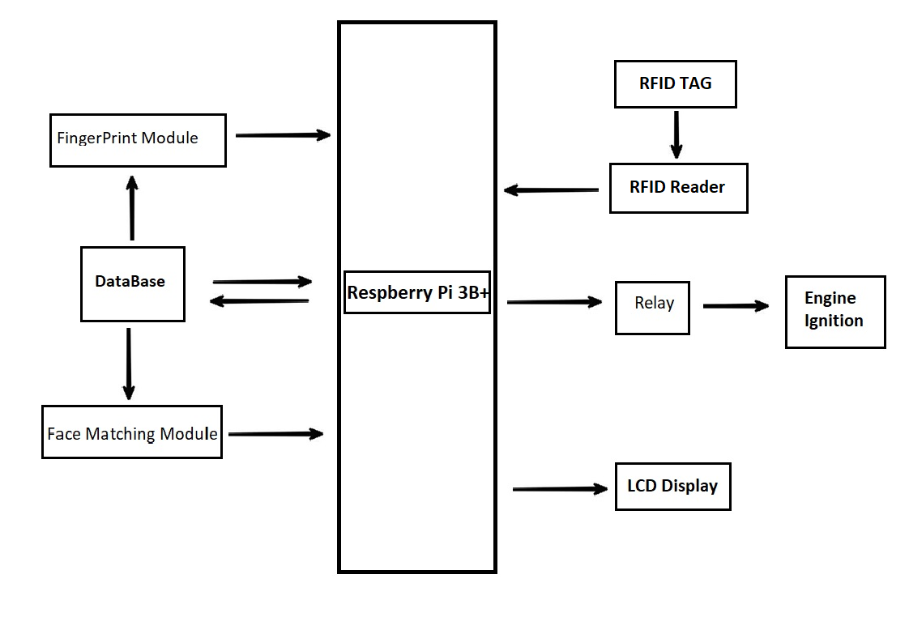
IV. Roadmap/Flow Diagram

Slide 8
